Slide 1
Mini Project in CE143:CCP
082
Harsh patel
Achyut Krishna Sai

Slide 2
Printing Pattern Using Loops
Print a pattern of numbers from to as shown below. Each of the numbers is separated by a single space.
4 4 4 4 4 4 4
4 3 3 3 3 3 4
4 3 2 2 2 3 4
4 3 2 1 2 3 4
4 3 2 2 2 3 4
4 3 3 3 3 3 4
4 4 4 4 4 4 4
Input Format
The input will contain a single integer .
Constraints
1≤n≤1000
Link : https://www.hackerrank.com/challenges/printing-pattern-2/problem

Slide 3
Sample Input 0
2
Sample Output 0
2 2 2 2 1 2 2 2 2
Sample Input 1
5
Sample Output 1
5 5 5 5 5 5 5 5 5
5 4 4 4 4 4 4 4 5
5 4 3 3 3 3 3 4 5
5 4 3 2 2 2 3 4 5
5 4 3 2 1 2 3 4 5
5 4 3 2 2 2 3 4 5
5 4 3 3 3 3 3 4 5
5 4 4 4 4 4 4 4 5
5 5 5 5 5 5 5 5 5
Sample Input 2
7
Sample Output 2
7 7 7 7 7 7 7 7 7 7 7 7 7
7 6 6 6 6 6 6 6 6 6 6 6 7
7 6 5 5 5 5 5 5 5 5 5 6 7
7 6 5 4 4 4 4 4 4 4 5 6 7
7 6 5 4 3 3 3 3 3 4 5 6 7
7 6 5 4 3 2 2 2 3 4 5 6 7
7 6 5 4 3 2 1 2 3 4 5 6 7
7 6 5 4 3 2 2 2 3 4 5 6 7
7 6 5 4 3 3 3 3 3 4 5 6 7
7 6 5 4 4 4 4 4 4 4 5 6 7
7 6 5 5 5 5 5 5 5 5 5 6 7
7 6 6 6 6 6 6 6 6 6 6 6 7
7 7 7 7 7 7 7 7 7 7 7 7 7

Slide 4
Code :
#include <stdio.h>
#include <string.h>
#include <math.h>
#include <stdlib.h>
int main()
{int n,i,j;
scanf("%d", &n);
// Complete the code to print the pattern.
int size = 2 * n - 1;
int start = 0;
int end = size - 1;
int a[size][size]; //a[13][13]
while (n != 0) //4
{ for (i = start; i <= end; i++)
{for (j = start; j <= end; j++)
{ if (i == start || i == end || j == start || j == end)
a[i][j] = n; ;
}
}
++start;
--end;
--n;
}
for(i = 0 ; i < size ; i ++)
{
for( j = 0 ; j < size ; j ++)
printf("%d ",a[i][j]);
printf("\n");
}
return 0;
}

Slide 5
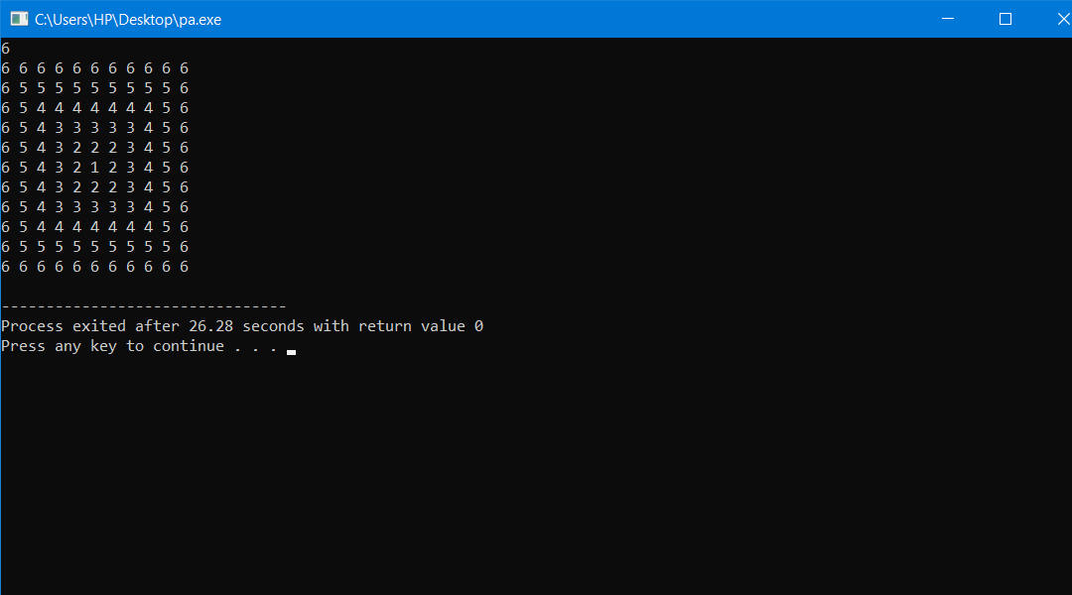
Output

Slide 6
Sorting Array of Strings
To sort a given array of strings into lexicographically increasing order or into an order in which the string with the lowest length appears
first, a sorting function with a flag indicating the type of comparison strategy can be written The disadvantage with doing so is having to
rewrite the function for every new comparison strategy. A better implementation would be to write a sorting function
that accepts a pointer to the function that compares each pair of strings. Doing this will mean only passing a pointer to the
sorting function with every new comparison strategy.
Given an array of strings, you need to implement a String Sort function which sorts the strings according to a comparison function, i.e, you need to implement the function :
void string_sort(const char **arr,const int cnt, int (*cmp_func)(const char* a, const char* b)){ }

Slide 7
The arguments passed to this function are:
an array of strings : arr length of string array: count pointer to the string comparison function: cmp_func
You also need to implement the following four string comparison functions:
lexicographic_sort (char* a, char* b) to sort the strings in lexicographically non-decreasing order.
lexicographic_sort_reverse (char* a,char* b) to sort the strings in lexicographically non-increasing order.
sort_by_number_of_distinct_characters(char* a, char* b) to sort the strings in non-decreasing order of the number of distinct characters present in them. If two strings have the same number of distinct
characters present in them, then the lexicographically smaller string should appear first.
4. sort_by_length(char* a,char* b) to sort the strings in non-decreasing order of their lengths. If two strings have the same length, then the lexicographically smaller string should appear first.

Slide 8
Input Format
You just need to complete the function string\_sort and implement the four string comparison functions.
Constraints
1 ≤No. of Strings ≤ 50
1 ≤Total Length of all the strings ≤ 2500
You have to write your own sorting function and you cannot use the inbuilt qsort function
The strings consists of lower-case English Alphabets only.
Output Format
The locked code-stub will check the logic of your code. The output consists of the strings sorted according to the four comparsion functions in the order mentioned in the problem statement.

Slide 9
Sample Input 0
4
wkue
qoi
sbv
fekls
Sample Output 0
fekls
qoi
sbv
wkue
wkue
sbv
qoi
Fekls
qoi
sbv
wkue
fekls
qoi
sbv
wkue
fekls

Slide 10
Code

